Slide 1


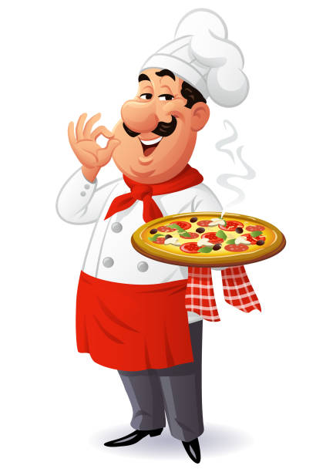
Catering Management
Rajeev Institute Of Technology
Department Of Computer science
Team Members:
Sneha.J.R 4RA21CS086
Amrutha.T.R 4RA22CS004
Kavana.B 4RA22CS044
Kavana.K.S 4RA22CS046
Guide:
Chiranjeevi.M.R

Slide 2

CONTENTS
Introduction
Abstract
Existing system and proposed system
Objectives of the Project
Tools and Technologies Used
Methodology
Results
Analysis
Future Scope
Conclusion

Slide 3

Abstract
User-Friendly Interface:
Accessible to both caterers and clients, ensuring
easy communication and collaboration.
Order Processing:
Streamlines the handling and management of
catering orders.
Menu Customization:
Allows clients to customize their catering menus
as per their preferences.
Inventory Management:
Helps track and manage inventory efficiently.
Organizes and maintains customer information
for better

Slide 4

Introduction
Order Management:
Customers place orders through a web-based application instead of using paper and pen.
For customers: Reduced waiting time for order placement.
For catering owners: Reduced manpower costs.
Main Purpose:
Generate bills and provide item details to customers.
Reports:
Daily transaction details.
Employee information (new hires, salary calculations).

Slide 5
Existing system:
System relies on large numbers of manpower to handle customer reservation, inquiry, ordering food, placing order, reminding dishes.
This typical method is kind of wasting of time and energy when there are a lot of customers at that time.
However, if there are too many waiters to be hired, it may be waste of resource during This nonpeak hour.
It also will give an extra-work to the cashier.

Slide 6
Proposed system :
This system requires the customer to make an order through their web-based application.
It will reduce time waiting by the customer
catering owner can reduce the expenses on manpower.
Real-Time order tracking System.
Intelligent chatbot system.
Augmented Reality dining Experience.

Slide 7
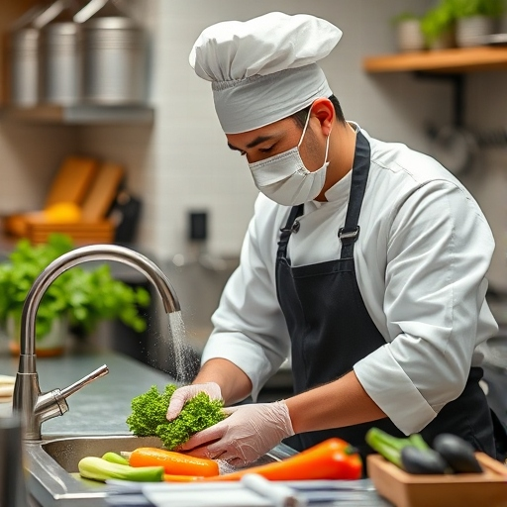
OBJECTIVES OF THE PROJECT
Control Catering Budget & Contracts:
Manage costs for food, beverages, and snacks
Food Preparation to Quality Standards:
Ensure food is prepared according to approved quality standards for safety and taste.
Maintain Food Hygiene:
Supervise and maintain high standards of food hygiene at all times
Fod Delivery:
Deliver meals to patients and staff restaurants, ensuring timely and safe distribution.

Slide 8

TOOLS AND TECHNOLOGIES USED
PHP: The primary programming language used to develop the frontend functionality
XAMPP Server: A software package that includes Apache, MySQL, and PHP, used as the local server.
MySQL Database: Used for managing and storing data related to customers, orders, inventory, and feedback.
HTML/CSS: Utilized for designing the user interface (UI) and ensuring a responsive and user-friendly experience.

Slide 9
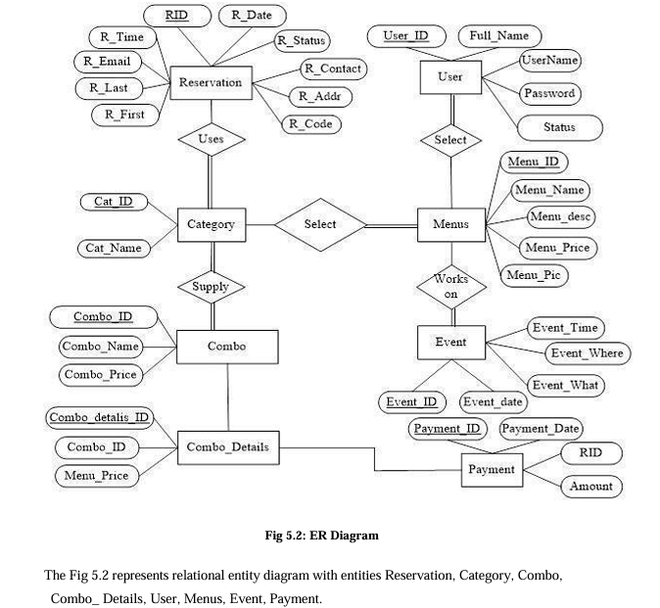
Methodology

Slide 10
RESULTS :
Improved Efficiency: The catering management system reduced the average time spent on managing catering orders by 30%.
Increased Accuracy: The system eliminated errors in ordering and inventory management, resulting in a 25% reduction in food waste.
Enhanced Customer Satisfaction: The system enabled catering staff to respond promptly to customer inquiries.
Reduced Costs: The system optimized inventory management, resulting in a 15% reduction in food costs.

Slide 11
ANALYSIS :
Streamlined Operations: The catering management system automated many manual tasks, freeing up staff to focus on higher-value tasks.
Data-Driven Decision Making: Its enabling data-driven decisions to improve efficiency and reduce costs.
Scalability: The system easily handled increased demand during peak periods, ensuring that catering operations ran smoothly.
Integration: The system integrated seamlessly with existing systems, minimizing disruption to catering operations.

Slide 12
FUTURE SCOPE :
The catering industry is evolving significantly, moving away from traditional food delivery models to focus on modern banquet and its extended to bulk food delivery.
Consumers are increasingly opting for caterers because of its convenience and the bulk food delivery,

Slide 13
CONCLUSION :
Designed for large catering events like weddings and parties.
Focuses on providing healthy and nutritious meals.
Helps businesses run smoothly and improve efficiency.
Enhances customer service.
Increases productivity and profitability.
Provides a competitive advantage in the market.

Slide 14
REFERENCE
https://www.w3schools.com/php/default.asp
https://www.sitepoint.com/php/
https://www.php.net/
https://www.mysql.com/
http://www.mysqltutorial.org
https://www.apachefriends.org/download.html
Fundamentals of Web Development by Randy Connolly | Ricardo Hoar

Slide 15


